Slide 1
Case Study: How Does a Bike-Share Navigate Speedy Success?
Capstone Project – Google Data Analytics Course
Author: Maximilian Kemkes
Date of Analysis: 25.08.2022

Slide 2
Bike Share Drivers of Success & Customer Behaviour
Goal of the Analysis: What do we want to achieve?
Data story: The differeince in customer behaviour
Conclusion
Appendix

Slide 3
What do we want to achieve?

Slide 4
Objective
Identify if there is a difference in in user behaviour between Cyclistic members and casual customers.

Slide 5
Difference in customer behaviour

Slide 6
Do members and casual riders use different bike types?

Slide 7
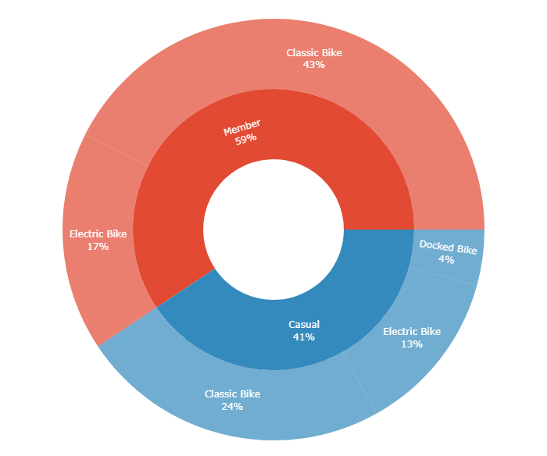
Ride type
Members comprise 59% of rides and chose the Classic Bike 72%
Take-Away:
Docked Bike only used by Casual riders
Casual riders use the Classic Bike less often than Members
Casual riders make up 41% of rides and chose the Classic Bike 59%

Slide 8
How far do people ride? Is there a difference between the two groups?

Slide 9
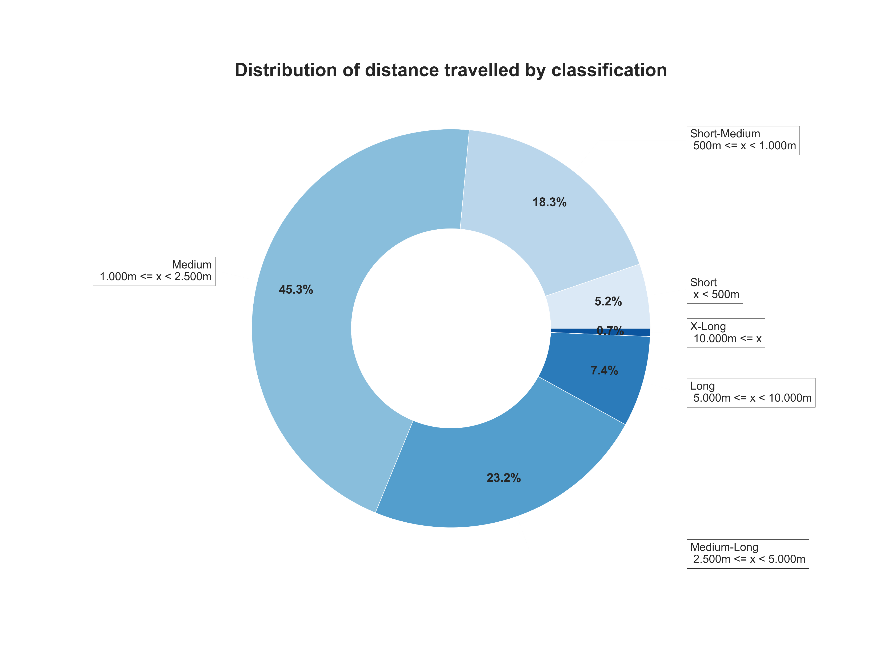
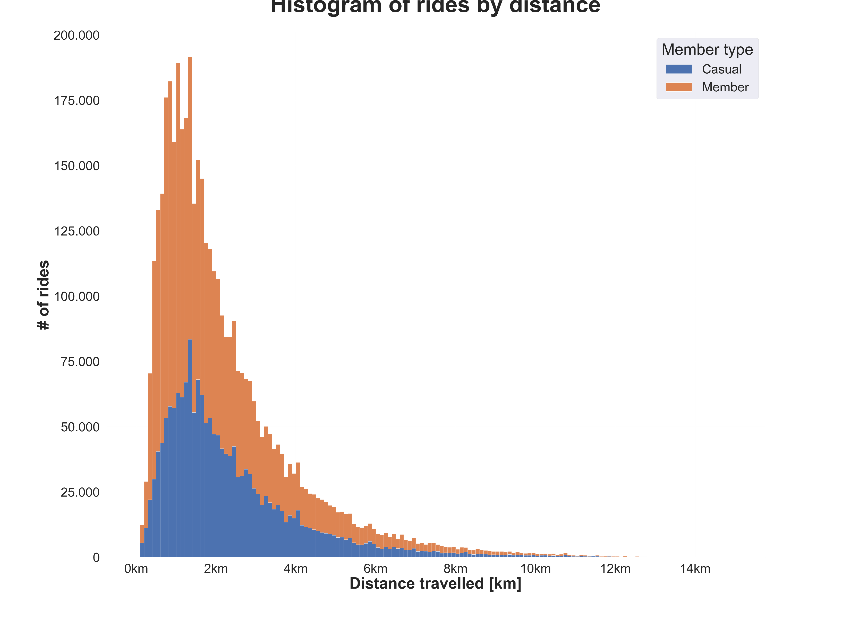
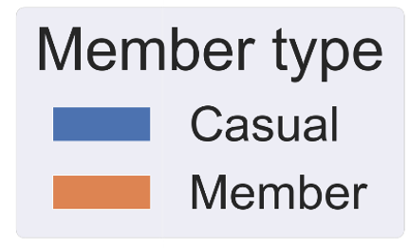
Distribution of ride distance

Slide 10
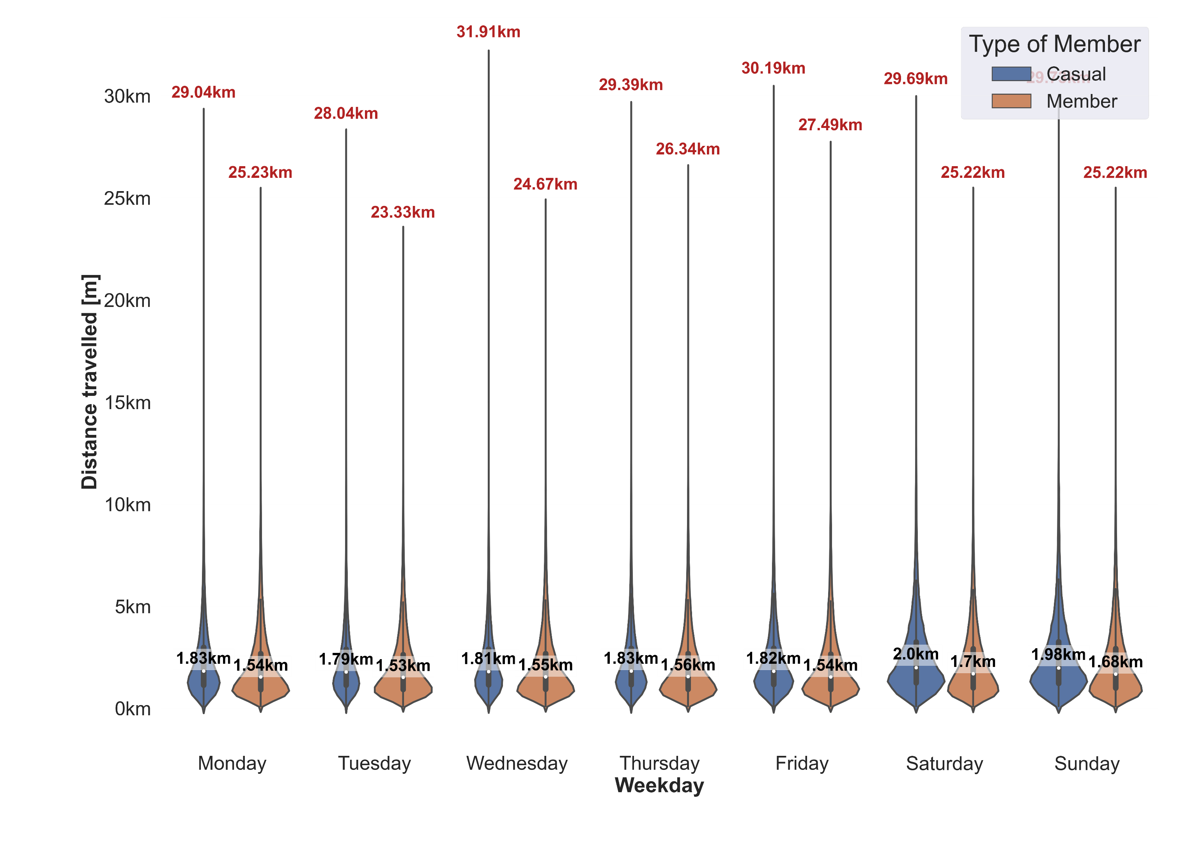
Ride distance by Day
Take-Away:
Casual riders ride longer distances
Members ride constantly throught the week,
Casual riders concentrate on the weekend
Both parties ride longer distances on the weekend

Slide 11
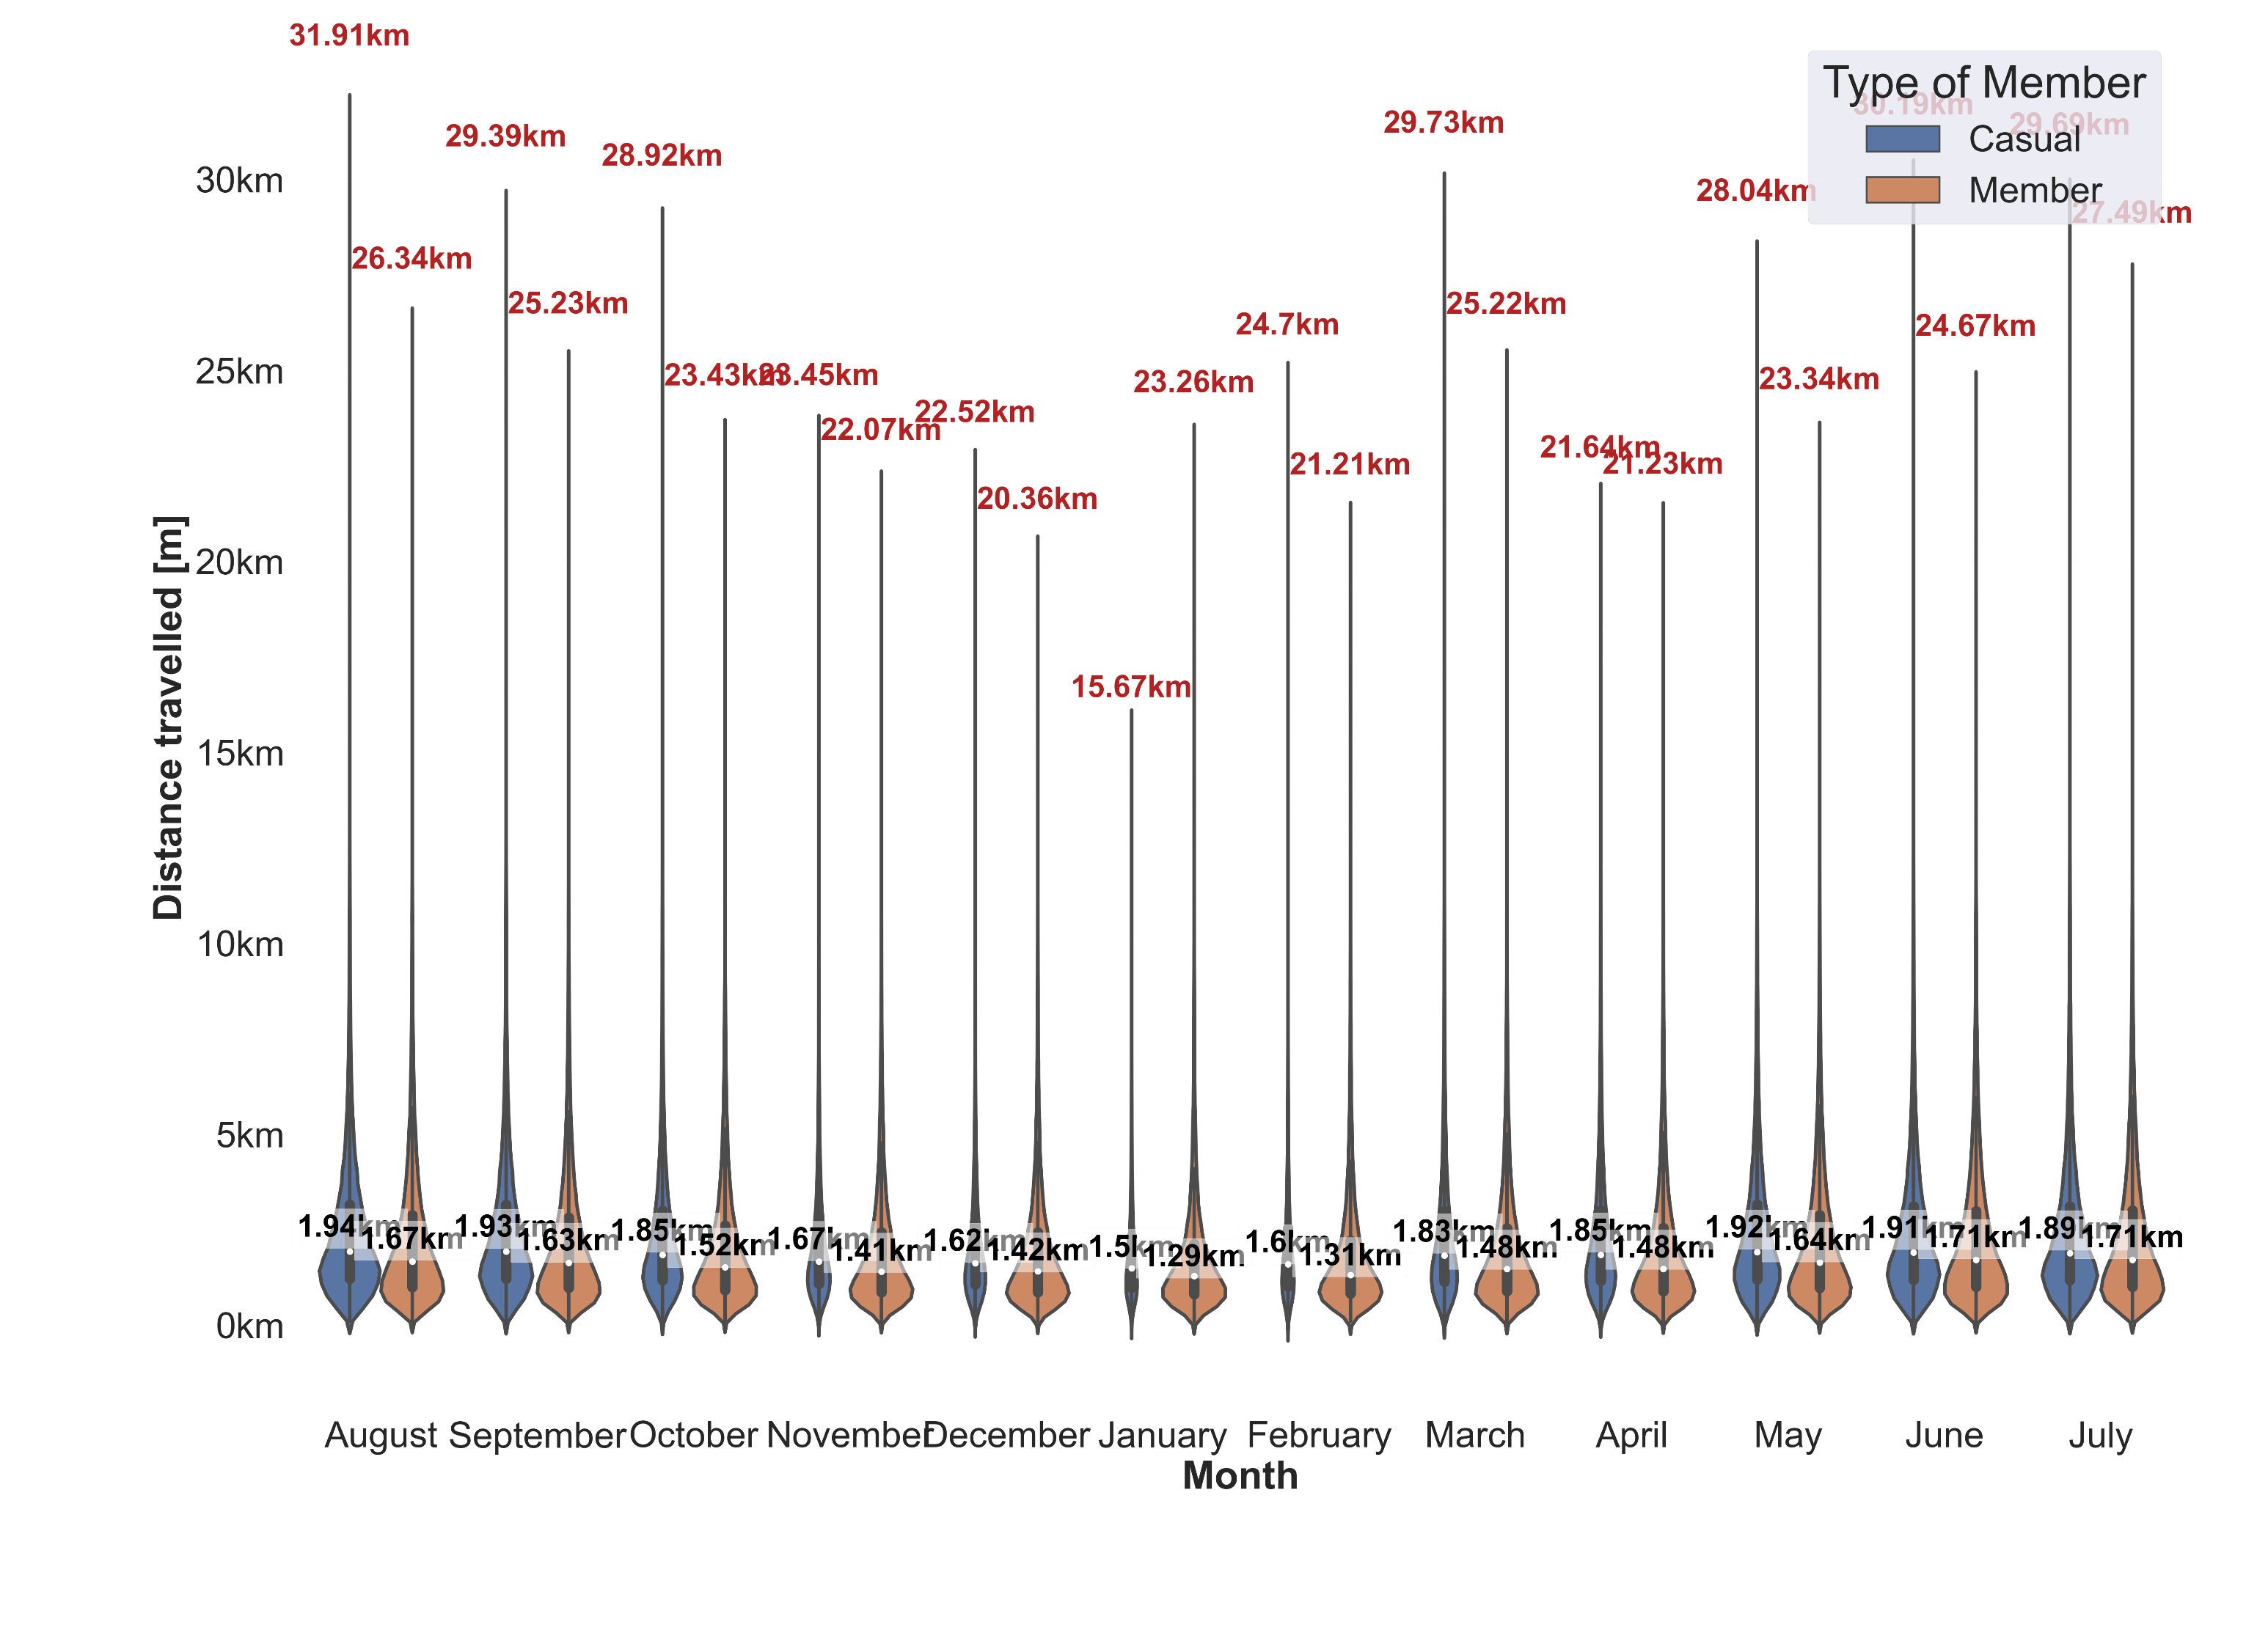
Ride Distance by Month
Take-Away:
Members ride constantly throught the year,
Casual riders concentrate on non winter months
Both parties ride less during winter

Slide 12
How long do people ride? Is there a difference between the two groups?

Slide 13
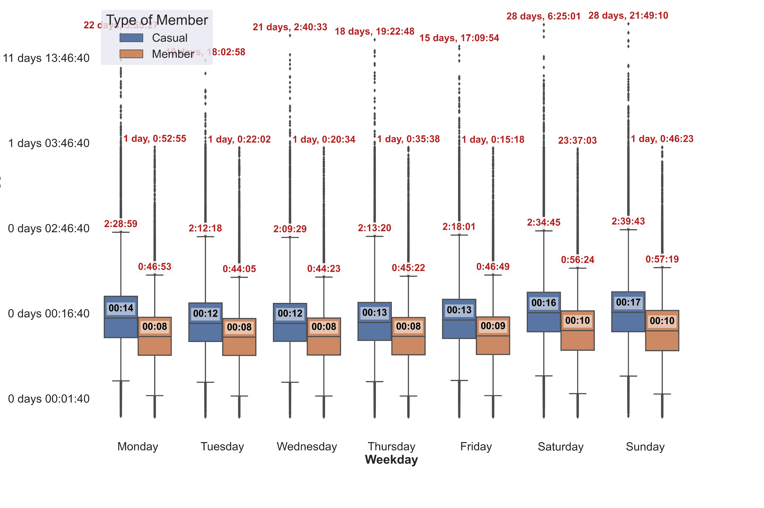
Ride Length by Day
Take-Away:
Casual riders have 50% longer median times
Both parties ride longer times on the weekend (approx + 20%)

Slide 14
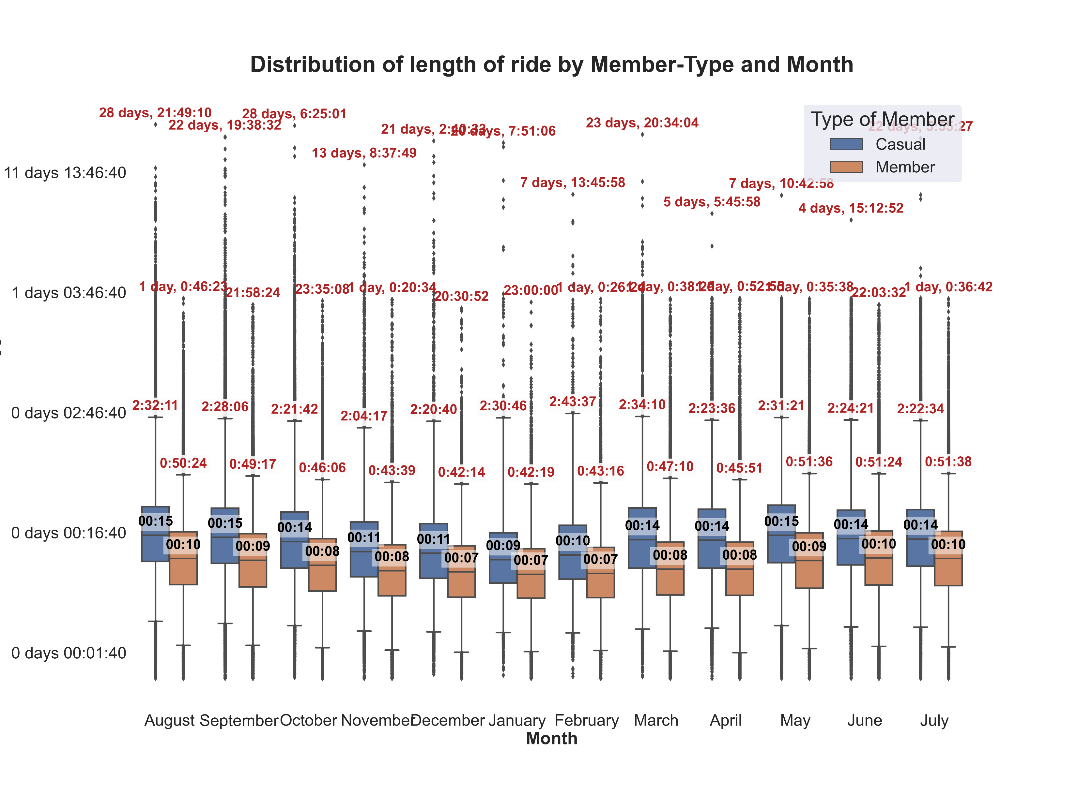
Ride Length by Day
Take-Away:
Both parties ride shorter times in the winter months
Casual riders have a stronger drop in ride times: 35% vs 20% for Members

Slide 15
Is there a relationship between time and distance? Is it different for each group?

Slide 16
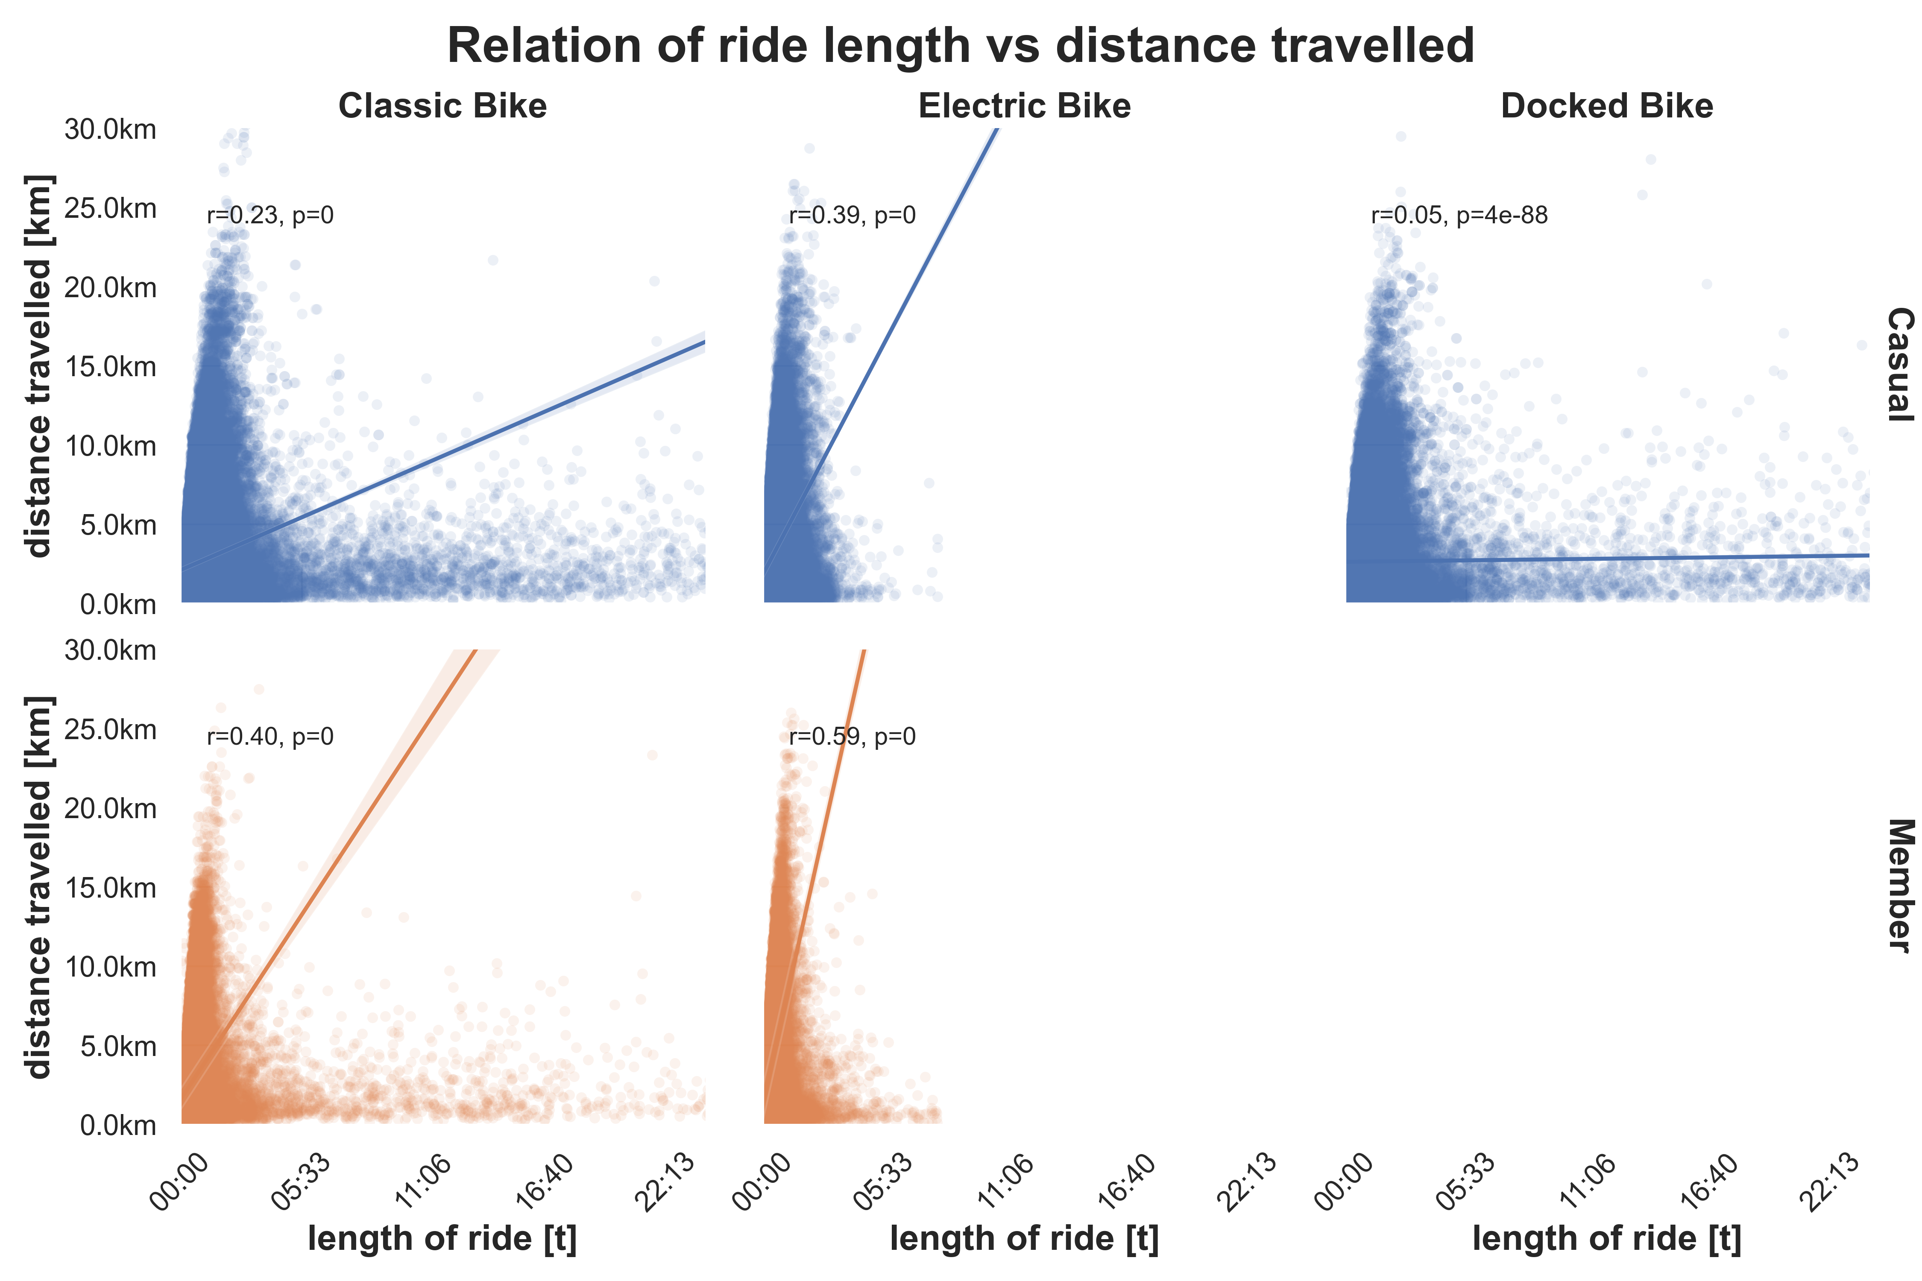
Relation: ride length vs distance
Take-Away:
Members ride faster and have a higher correlation
Casual riders are slower and distance is not impacted by the length that much ➔ hypothesis: more leisure and breaks inbetween
Almost no correlation for docked bike ➔ length of ride does not determine the distance

Slide 17
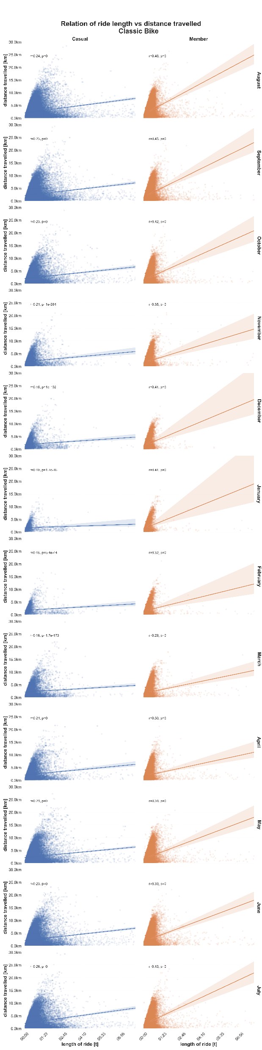
Classic bike: ride length vs distance
Take-Away:
Winter months are slowest for both
Casual riders have the lowest correlation in winter months (approx. r = 0.1)
Correlation for Members almost does not change throughout the year (approx. r = 0.4)
Hypothesis:
During cold and harsh weather both groups have trouble riding the classic bike
Shorter rides in winter (like shown before) could also lead to more traffic stops and slow down leading to less speed
Casual riders are parking their bikes during their rides.

Slide 18
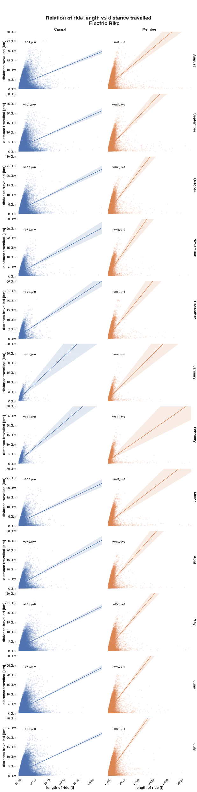
Electric bike: ride length vs distance
Take-Away:
Casual riders have a slightly higher correlation in winter months and a faster speed
In contrary Members have a slower speed during winter while correlation stays mostly same
Hypothesis:
Members struggle to keep up their pace in winter due to potentially harsher conditions (snow, wind, rain)
Casual riders are picking up their pace to reach their goal faster

Slide 19
Is there a certain area or routes preferred by the two groups?

Slide 20
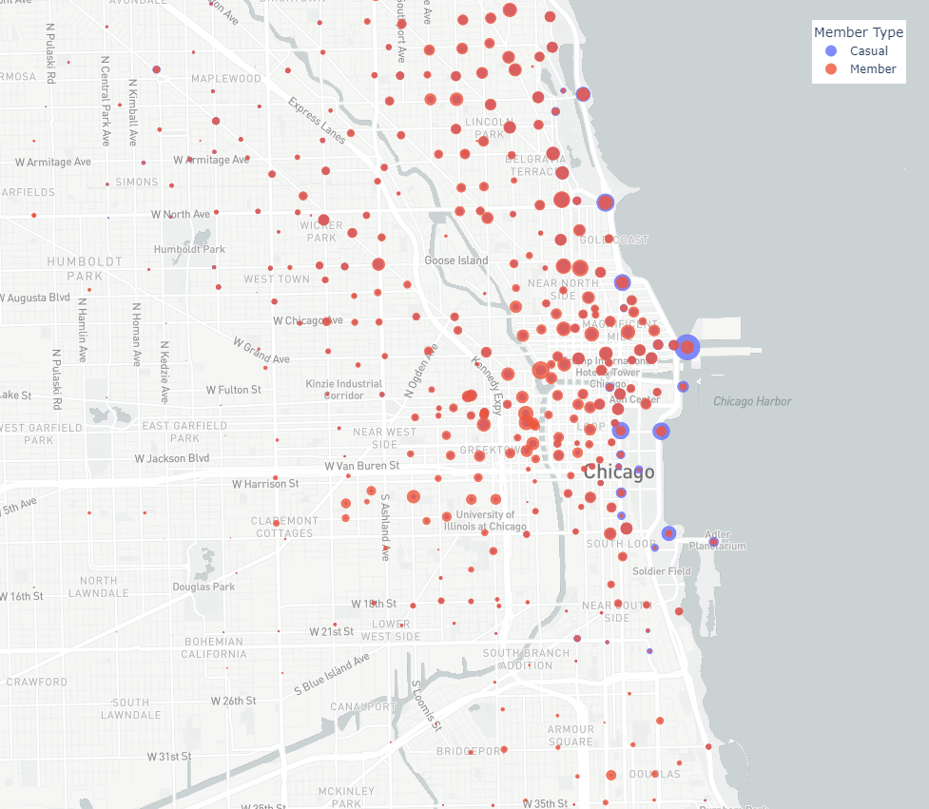
Stations and areas used
Take-Away:
Casual riders have a clear preference for park stations and stations near the Lake Michigan
Members are more evenly distributed but concentrate in the city center and around working areas

Slide 21
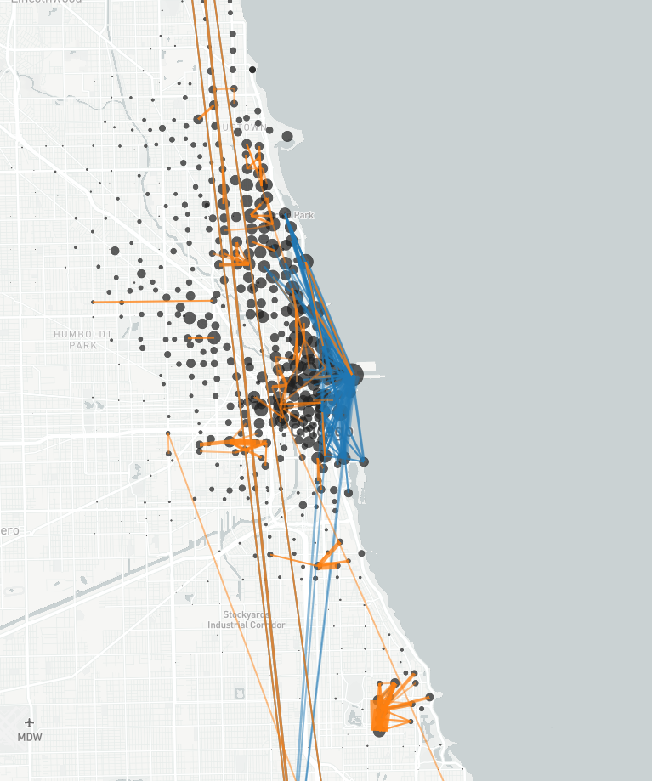
Stations and areas used
Take-Away:
Casual riders mostly ride in parks and near the lake
Members use the bike as transportation throughout the city and (long distances) and in certain hubs like work areas or university (short distances)

Slide 22
Conclusion

Slide 23
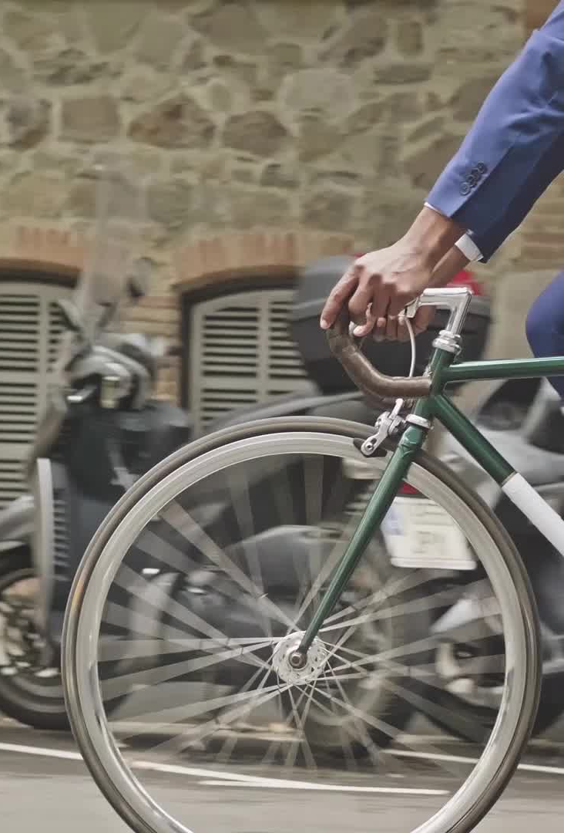
Differences in Behavior
Length [t] and Distance [m]
Members ride slightly shorter but faster rides | Casual riders ride longer, but slower with potentially more breaks
Time and Season
Members ride roughly the same during the week and during the year | Casual riders focus on weekends and non-winter months
Geogrphy
Members ride throughout the city and around small hubs | Casual riders focus parks and near the Lake Michigin

Slide 24
Conclusion
Casual riders use Cyclist for leisure and recreation. They are focused on having a good time which is facilitated by free-time (weekends) and good conditions (spring, summer)
Members use Cyclist as a means of transportation. They want to get from Point A to Point B in as short of time as possible and use it in their everyday life: all days throughout the week and near their main locations like work or university.

